Slide 1
Valuing the Ticket Price in Big Mountain Resort Ski
Masoumeh Dehghani
15 Nov, 2021

Slide 2

Valuing the Ticket Price and Increasing Revenue in Big Mountain Resort Ski
Resort is placed in Montana with 350,000 visitor per season
New Installed chair lift resulted in increasing the operating costs by $1,540,000/season.
The resort's pricing strategy has been based on charging a premium above the average price of resorts in its market segment.
The market average does not provide the business with the relevance of facilities in ticket price
The price ticket should be increased at least by $0.88 to cover the additional cost.

Slide 3
Recommendation and key findings
Current price of ticket is undervalued considering the facilities of the resort
Price ticket can increased to $95.87 with the expected mean absolute error of $10.39.
We recommend to add a run, increase the vertical drop by 150 feet, install an additional chair lift, and add 2 acres of snow making in resort. This scenario support the ticket price increased by $9.90. Over the season, this could be expected to increase in revenue to the amount of $17,322,717

Slide 4
Modeling results and analysis: Modeling of data
Predication based on average of average of price ticket over different resorts
Price expect to be off by around $19
Predication based on linear regression model
Price expect to be off by around $11.7
Predication based on forest regressor model
Price expect to be off by around $10.39

Slide 5
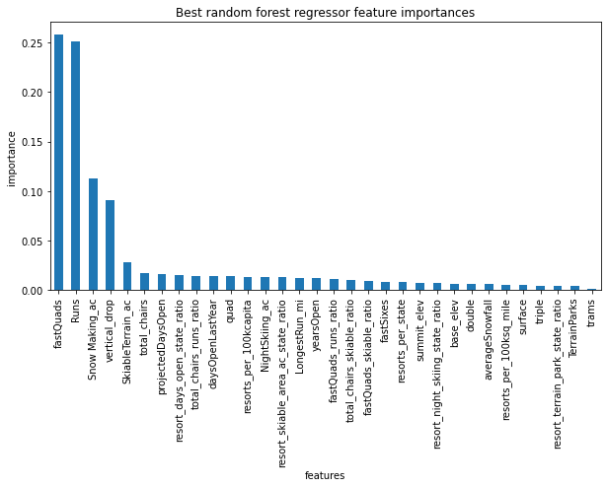
Modeling results and analysis: prediction of price
Predict of price ticket using Forest regressor model: $95.87 with the expected mean absolute error of $10.39

Slide 6
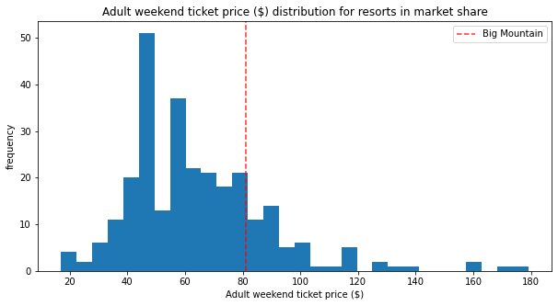
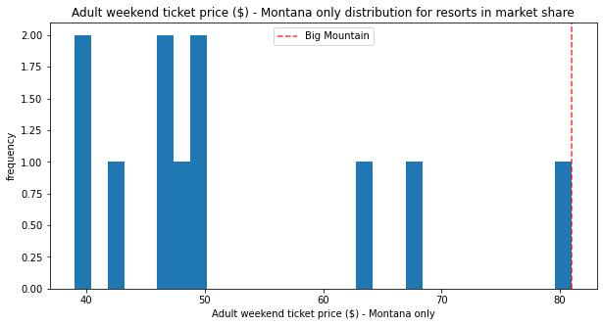
Modeling results and analysis
Current place of ticket price of Big mountain ski resort in province and country

Slide 7
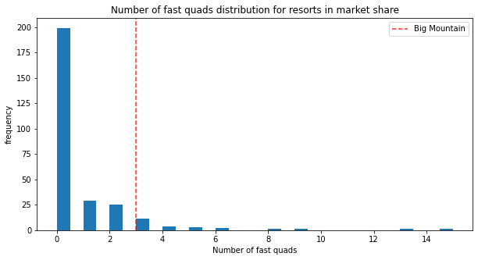
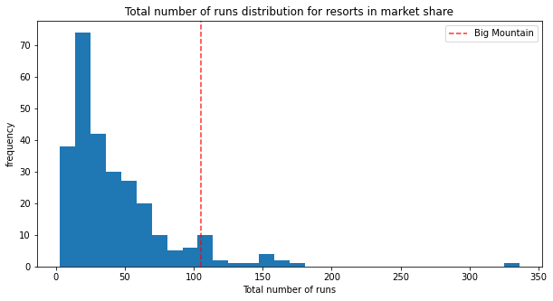
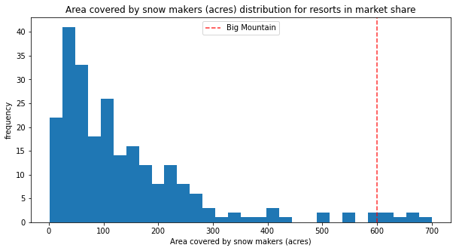
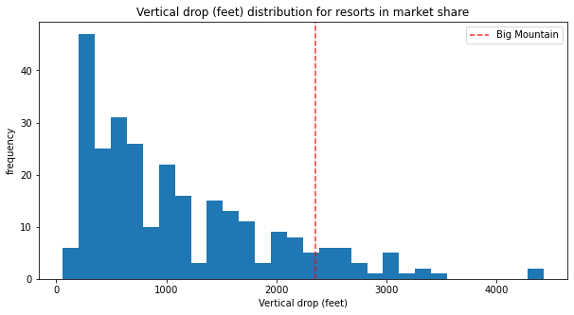
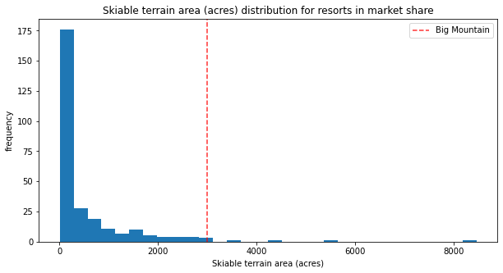
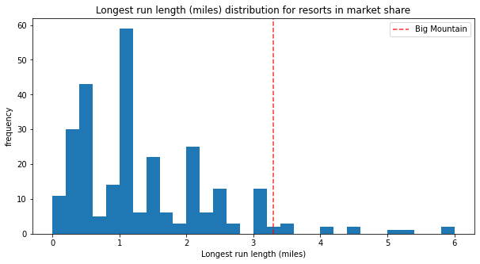
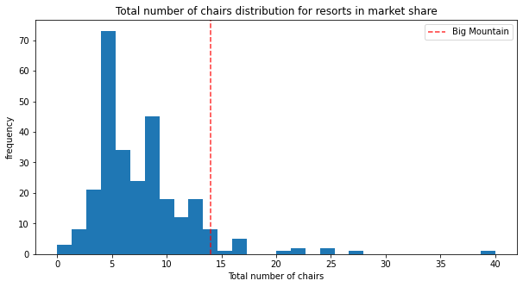
Modeling results and analysis: Position of Big mountain resort among resort skies in terms of facilities

Slide 8
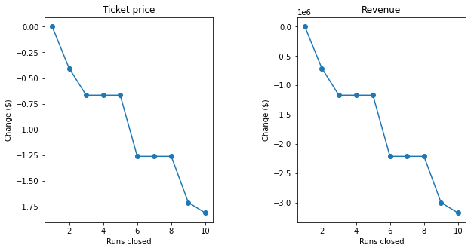
Modeling results and analysis: Different Scenarios
Scenario 1. Closing the runs

Slide 9
Modeling results and analysis: Different Scenarios
Scenario 2: adding a run, increasing the vertical drop by 150 feet, and installing an additional chair lift.
Support ticket price increased by $1.99 and revenue over season increased to the amount of $3,474,638 .
Scenario 3: Adding a run, increasing the vertical drop by 150 feet, and installing an additional chair lift, adding 2 acres of snow making.
Support ticket price increased by $9.90 and and revenue over season increased to the amount of $17,322,717.
Scenario 4: Increasing the longest run by .2 miles and guaranteeing its snow coverage by adding 4 acres of snow making capability.
Does not support increased price and so no difference in revenue.

Slide 10
Conclusion
Current price of ticket (81 $) in Big Mountain resort ski is under valued and it might be off by $19.
There is room to increase the price to maximum amount of $95.87, considering the expected mean absolute error of $10.39.
We analyized few different scenarios using different combination of features and we expect to increase even more the revenue by applying them.
Our recommendation is Scenario #3 which supports ticket price increased by $9.90 and and so revenue over season increased to the amount of $17,322,717.
It should be mentioned that the validity of this model lies in the assumption that other resorts accurately set their prices according to what the market supports.

